Slide 1
Software Coherence
For
Disciplined Parallelism
CS458
Xi Jin
Yang Song

Slide 2
Outline
1 Deterministic Parallel Java
--- an extension to Java that enforces deterministic-by-default semantics
---Data-race-free style
2 DeNovo
--- a software-managed cache coherence schema based on deterministic programming

Slide 3
Features
1 Fork-Join Parallelism
--pthread_create
--barrier
--pthead_join
Foreach()
{
//parallel
}
2 Regions:
Programmer should assign different region name to all the objects. Basically, it’s marking different memory location with regions. DPJ will check the determinism according to the region accesses.
3 Effect Summary:
Programmer should annotate methods with “effect summary” by marking what’s the region they want to read and write. Wrong summary may lead to compiling error. So programmer should know exactly what the data structure like , how they organize and which region they want to operate on.

Slide 4
How to guarantee determinism?
1 region checking
---Two iteration(Possibly grabbed by two threads ) cannot operate on the same region (show practical example)
int x in region A
foreach(i in 1,M )
{
x=1;
}
Compiler Warning!
int[] x in region [_]
foreach(i in 1,M )
{
x[i]=1;
}
Good to go!
2 region is hierachical
int x in region RED:A
int y in region RED:B
int z in region BLACK:A
Both x and y can be called RED:*

Slide 5
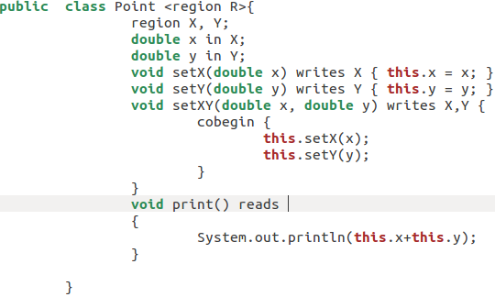
How to write correct DPJ effect?

Slide 6
Pros
1 programmer can really reason about program instead of writing wild parallelism
2 BUGs due to data race problem are easy to find
3 disciplined sequential program can easily covert to parallel version.
4 Next slide

Slide 7
How DPJ helps coherence?
1 Since there is no data race during the executing of parallel loop, two situation will not happen:
a two different processors writes to the same memory location
b one core reads the memory location another core’s writing on.
So why we should still keep directory coherence?
1 no directory shadow tag and sharing vector 2MB for #1024*16ways entries
2 no write invalidation traffic
3 no transient states
4 no indirection problem

Slide 8
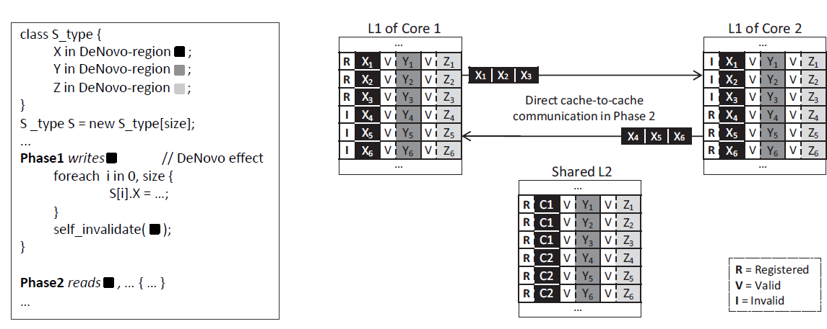
DeNovo
--- Only to remember last writer
--- self_invalidate(like explicit flush instruction) in Rigel insert at the end of phase

Slide 9
DeNovo
A bit thinking: if we still have to read x in phase3, L1 of core2 will visit L2 and “R”’s state will lead core2 to make cache-to-cache communication with L1 again. But if we let L1 of core2 keep that copy in “volatile” state and compiler predict next phase’s access pattern. Then tell the L1 of core2 to self-invalidate volatile copy before beginning of next phase.

